Slide 1


Introduction of Software Engineering
Software development life cycle, - Software Process Models: RUP (Rational Unified Process) Model
Presented By:
B.VAMSI
22551A4408
Data Science
Giet-(A)
Lecture Details:
Software Evolution and Methodologies
Software Engineering/Data Science, 2 Semester .

Slide 2
7. RUP Process Model
The Rational Unified Process (RUP) is a use-case driven, architecture-centric, iterative, and incremental process model.
The RUP focuses on creating and maintaining models rather than documentation.
It is derived from Unified Modeling Language (UML), which is an industry-standard language that helps to clearly communicate requirements, architectures, and designs.
The RUP is supported by tools which automate most of the activities of the process.
The RUP divides the development cycle into four consecutive phases; namely, inception, elaboration, construction, and transition.

Slide 3
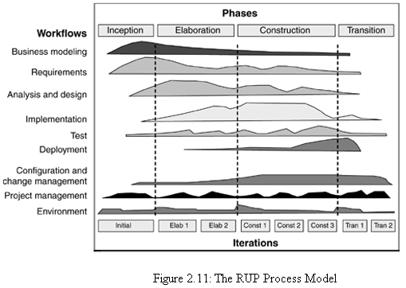
RUP Process Model

Slide 4
RUP Process Model
Inception phase:
It establish the business case for the system and delimit the project scope.
The business case includes success criteria, risk assessment, and estimate of the resources needed; and a phase plan showing dates of major milestones.
This phase produces vision document of the project, initial use-case model, initial risk assessment, business model, and a project plan showing the phases and iterations.
At this stage, customers will be clear with their requirement and life cycle objectives milestone will be produced.

Slide 5
RUP Process Model
Elaboration phase:
It analyzes the problem domain, establish an architectural framework, develop the project plan, and eliminate the highest risk elements of the project.
The architectural decisions have to be made with an understanding of the whole system: its scope, major functional and nonfunctional requirements.
In the elaboration phase, an executable architecture prototype is built in one or more iterations, depending on the scope, size, risk, and novelty of the project.
At the end of the elaboration phase, the second important project milestone will be the life cycle architecture milestone.

Slide 6
RUP Process Model
Construction phase:
During the construction phase, all application features are developed, integrated, and thoroughly tested.
This phase also focuses on the user manuals and the current release details.
At the end of this phase, a beta release becomes operational for the customers.

Slide 7
RUP Process Model
Transition phase:
The purpose of the transition phase is to move the software product to the user community for working.
This phase includes several iterations, including beta releases, general availability releases, as well as bug-fix and enhancement releases.
Effort is made in developing user-oriented documentation, training users, supporting users in their initial product use, and reacting to user feedback.

Slide 8
RUP Process Model
Each phase in the RUP can be further broken down into iterations.
Each iteration in the RUP mitigates risks, manage changes, provide reuse, and produces better quality products as compared to the traditional waterfall process.
The RUP is suitable for small development teams as well as large development organizations.
It can be found in a simple and clear process architecture that provides commonality across a family of processes.
Workflow represents the sequence of activities that produces a result of the observable value.
Workflows are divided into six core workflows (business modeling workflow, requirements workflow, analysis and design workflow, implementation workflow, test workflow, deployment workflow) and three supporting workflows (project management workflow, configuration and change management workflow, and environment workflow).

Slide 9
RUP Process Model
The RUP is a complete methodology in itself that emphasizes documentation.
It helps to proactively resolve project risks related with changing requirements.
The RUP process is openly published, distributed, and supported for operation.
It requires less time for integration of reusable components as the process of integration goes on throughout the software development life cycle.
However, some expertise is required to develop software using this methodology.
The development process is very complex and not well organized.

Slide 10


